Slide 1
Importance of Consumer Education – current situation:
Consumer education in Finland
Taina Mäntylä, The Finnish Competition and Consumer Authority

Slide 2
FCCA promote and implement consumer advocacy and education
    Taking part in curriculum planning work through statements, meetings and social media publications.
    Network and stakeholder cooperation, Finnish National Board of Education, the university teacher training joint events
    Cooperation with other authorities, NGO:s and private sector
    Nordic Estonian Consumer education working group
    Developing background materials like “Smart home” publication: https://www.kkv.fi/en/education/smart-home/

Slide 3
Changing consuming environment - Smart homes and data flows
MyData
Smart city
eHealth (social and health care)
MAAS
(mobility as a service)
Urban bio-production
Service robotics
SMART HOME
building as a platform
housing and freetime services
3D printing
(home production)
Solar energy
IoT
(internet of everything)
Broadband connection
(5G, fiber)
Networks base stations
Electricity sales/
sharing
Capacity sales/
sharing

Slide 4
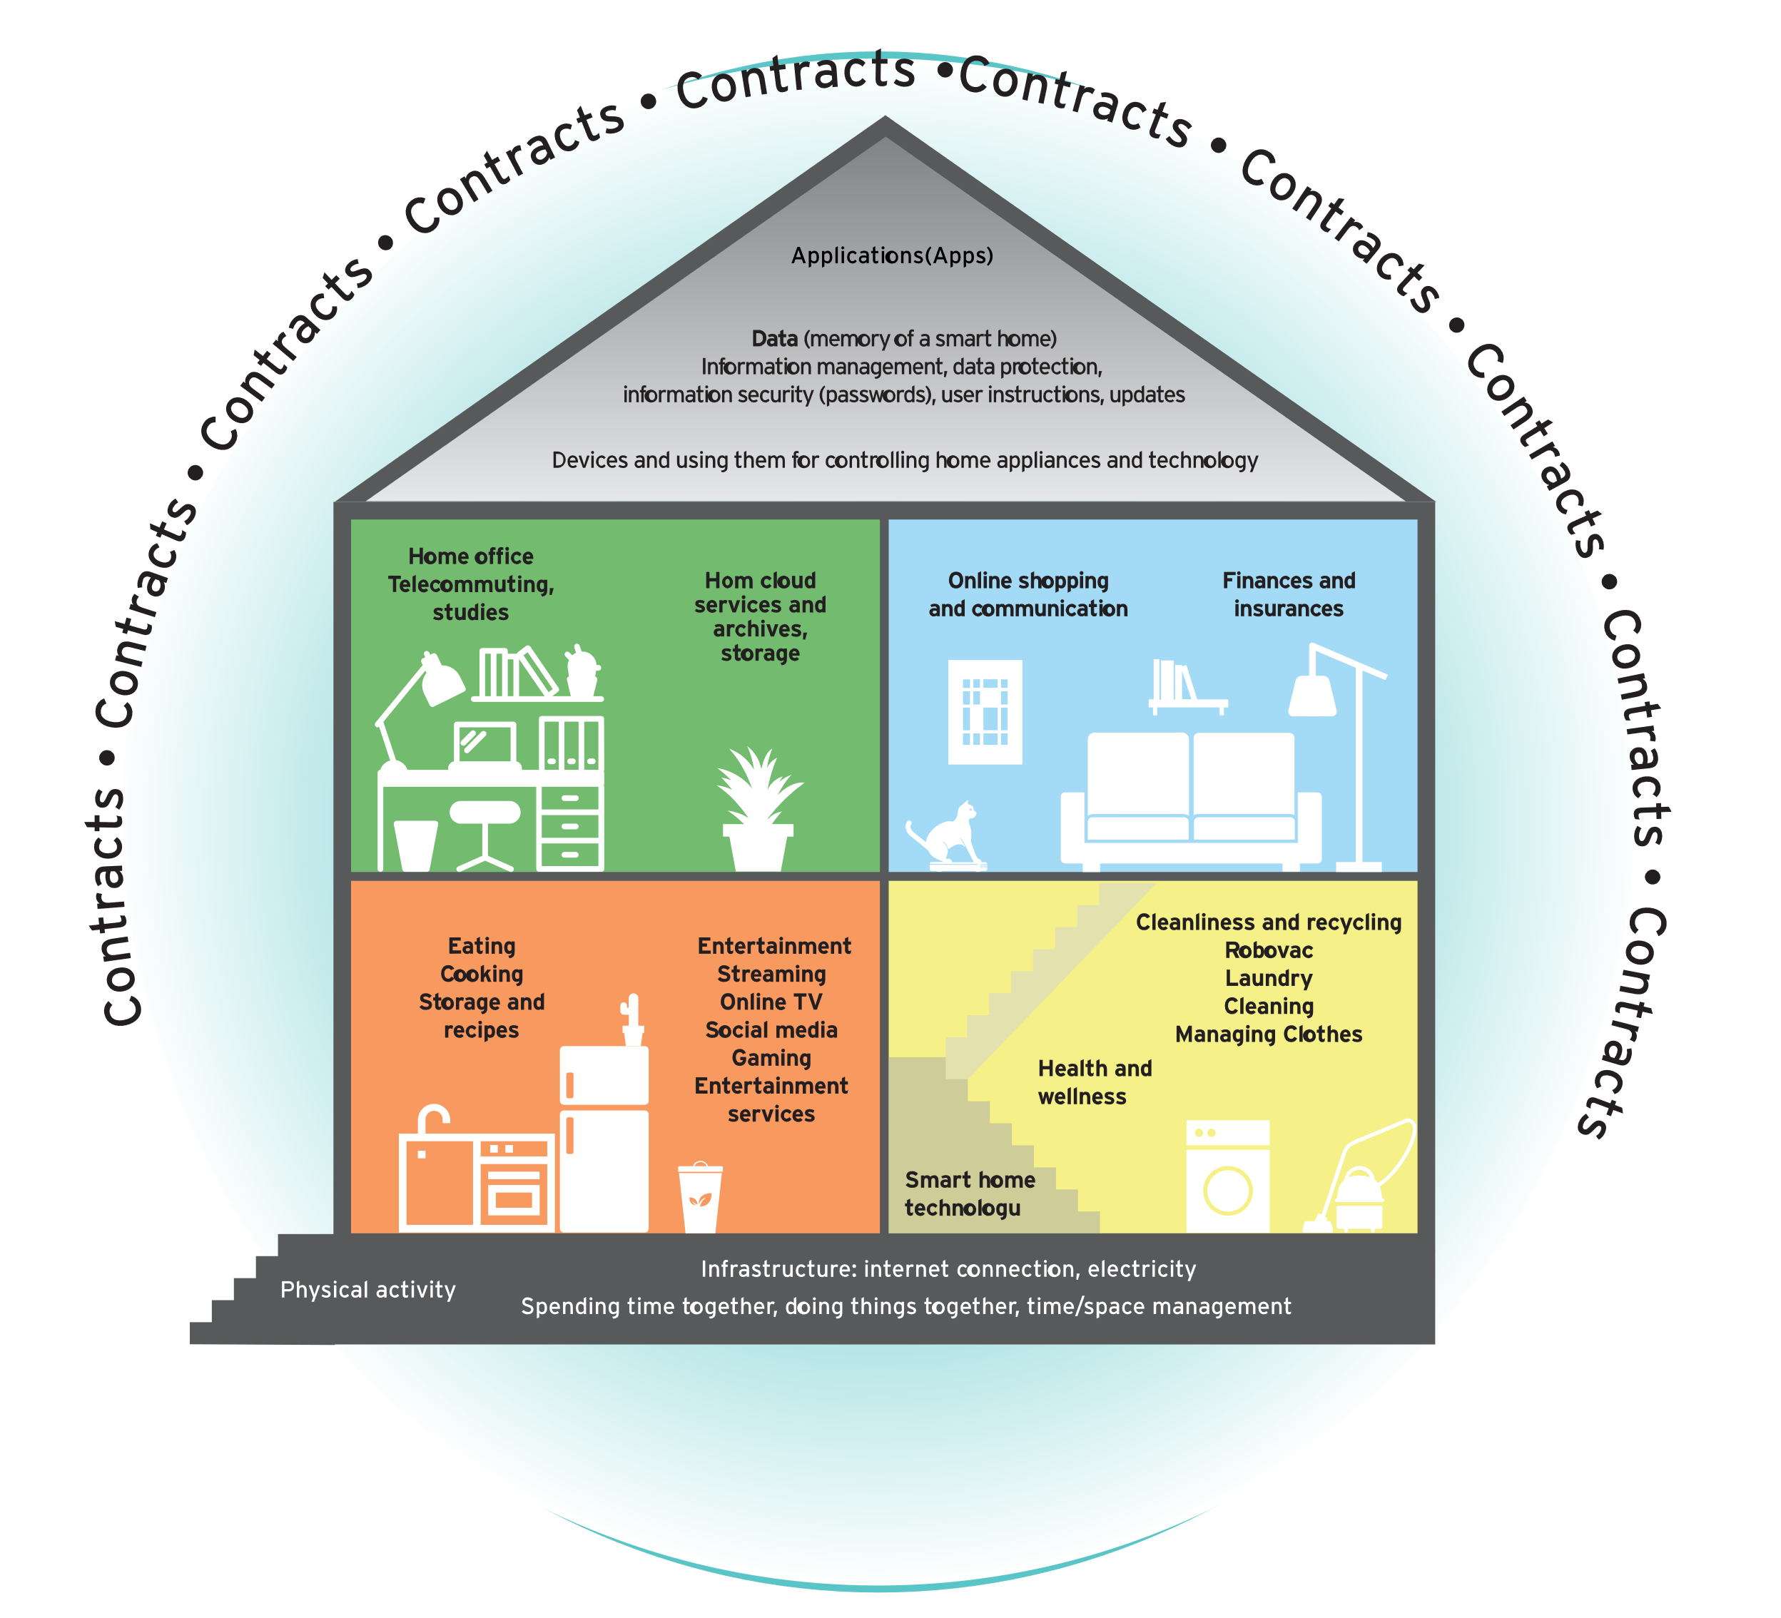
Smart home as consuming environment

Slide 5
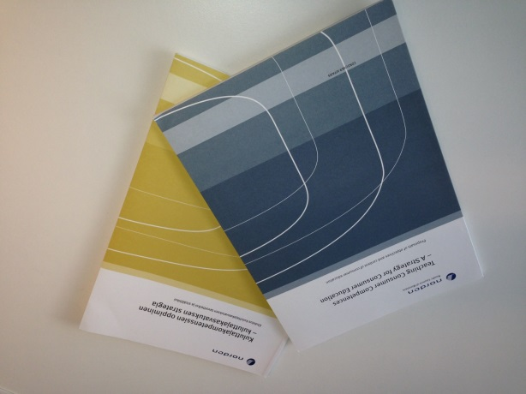
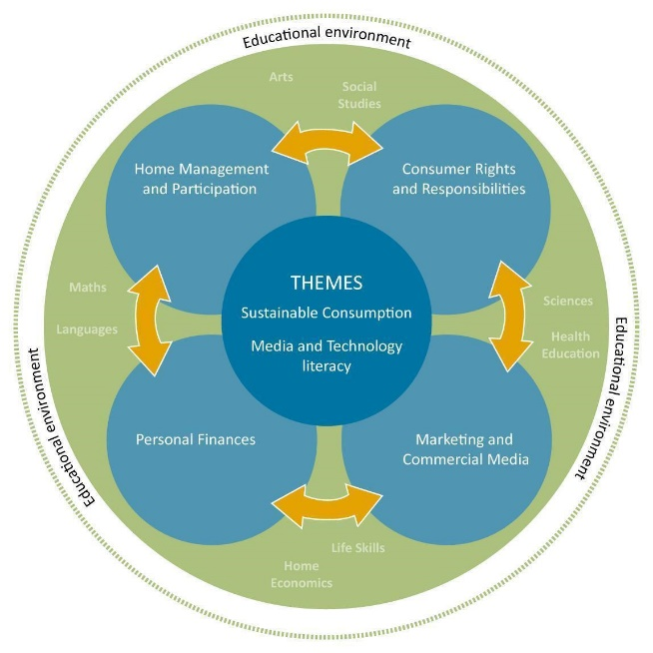
The framework for CE
“ Teaching consumer competences - a strategy for consumer education” and its appendix 1. ”Age relevant life skills – development of consumer competences”
The work is done in dialog with EU and OECD
NEW FRAMEWORK CE needed
Teaching consumer competences
Kuluttajakompetenssien oppiminen
Att undervisa om konsumentkompetens
Undervisning i forbrukerkompetanse
Tarbija käitumise ja oskuste õpetamine
Analysis of New Consumer Education in Nordic Schools (Japanese version)
Age relevant life skills, development of consumer competences

Slide 6
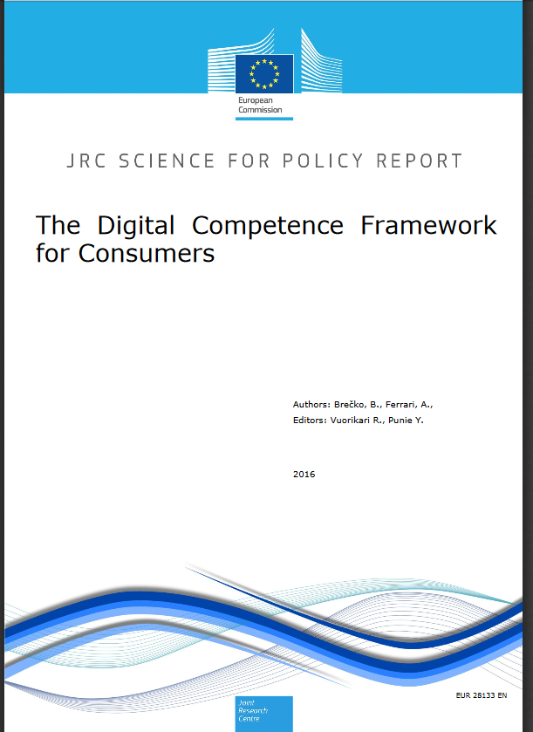
The Digital competences at market

Slide 7
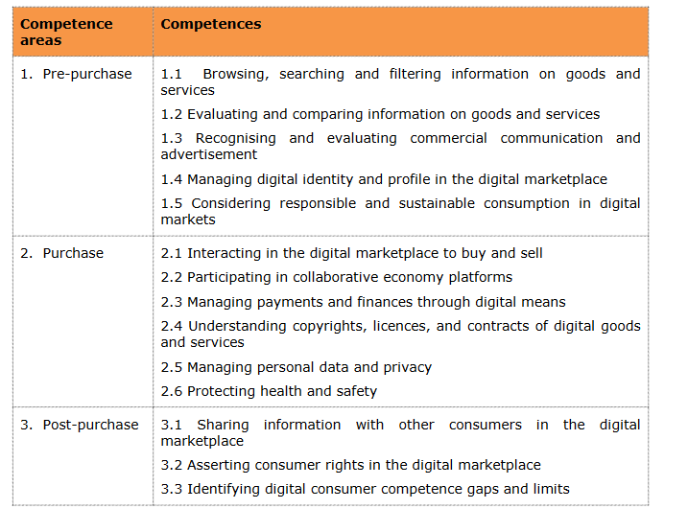
The purchasing path follows the consumer logic

Slide 8
Consuming process – purchasing path
Käyttö
Cost-
consciousness
Dreams
Cost-consciousness
Expenses and income
Cost-consciousness
Managing contracts
Active financial management
Sustainability
Environmental
consciousness
Dreams
Commercial communication → Consumer rights → Personal finances
→ Digital competences → Sustainability
Marketing
Needs
Purchases and agreements
/contracts
Faults or defects
Reklamation,
Rights and oblications
Re-order
Acquisition
Disposal Recycling Terminating contracts
Regular payments according to contracts
Product and service comparation
Payment
Usage
Usage
Judgement

Slide 9
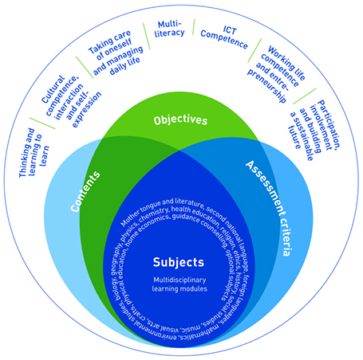
Curriculum 2016
Source: National board of education

Slide 10
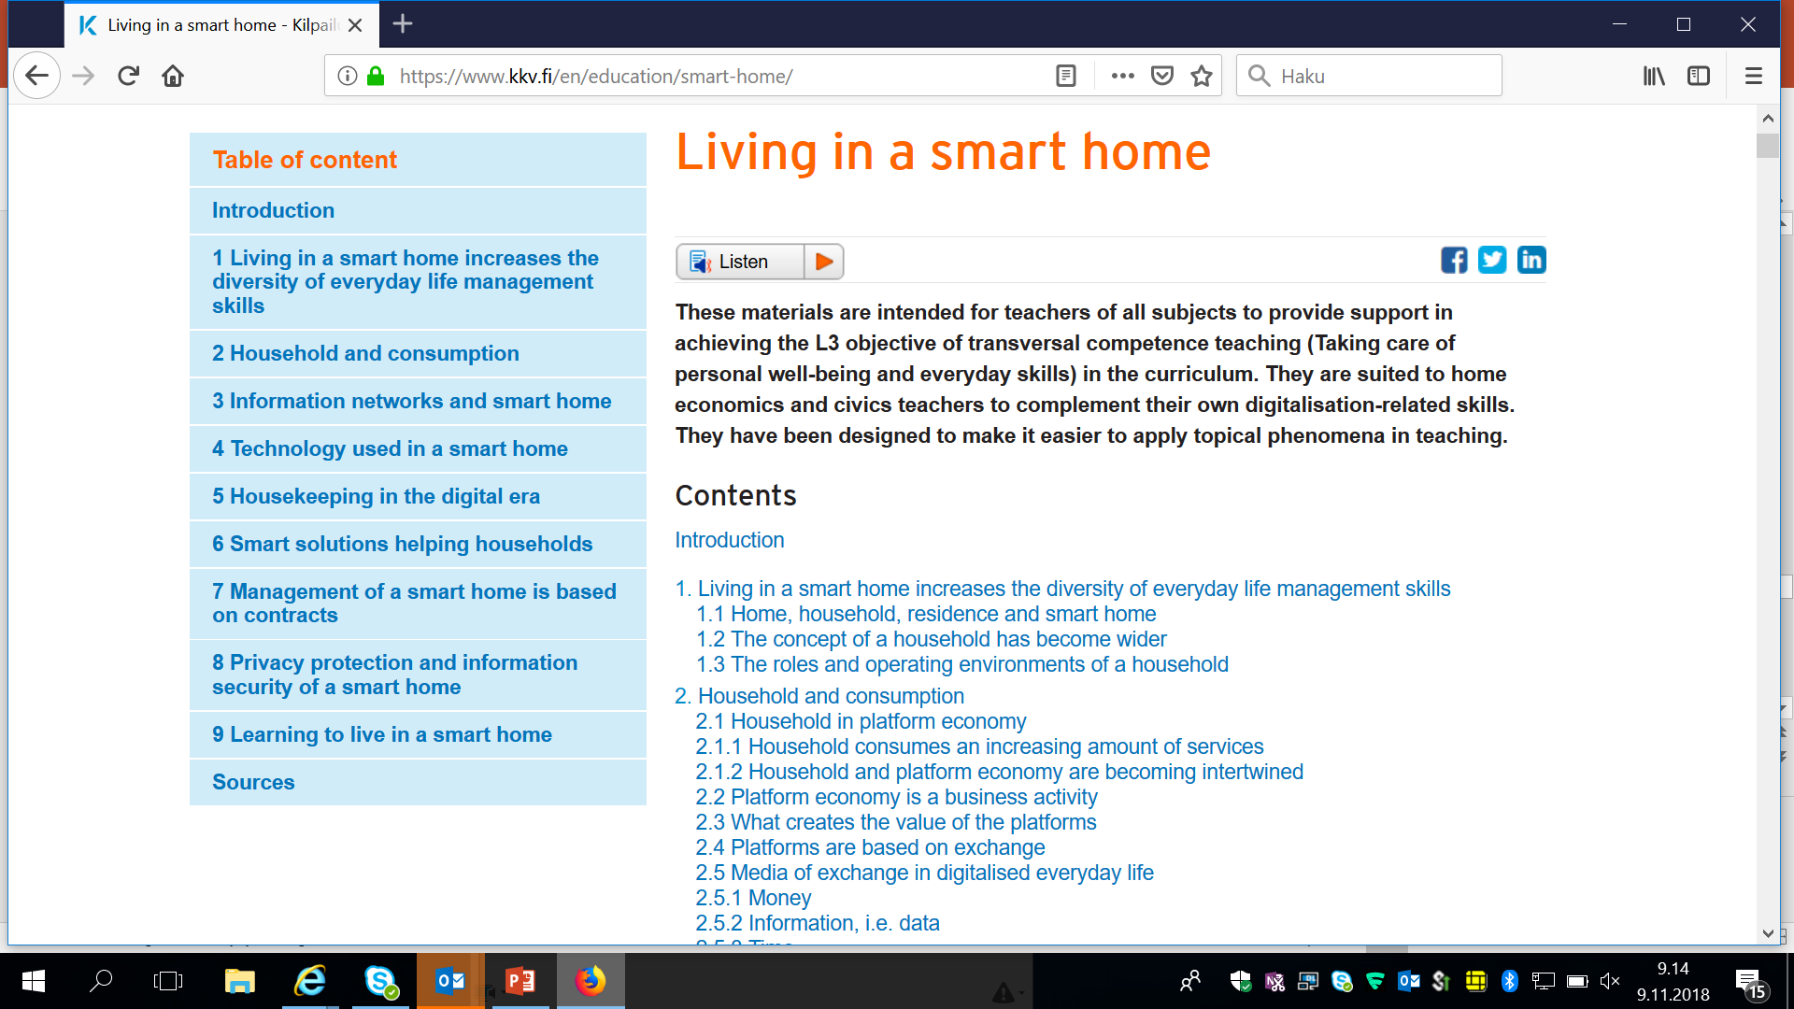
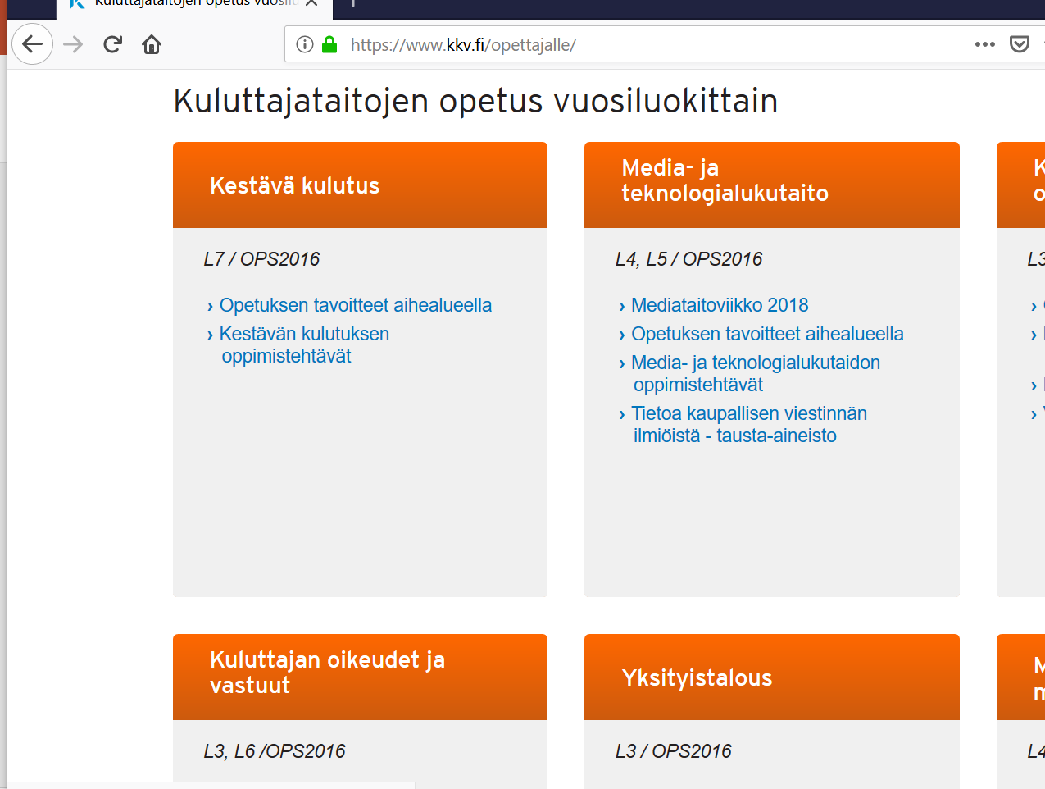
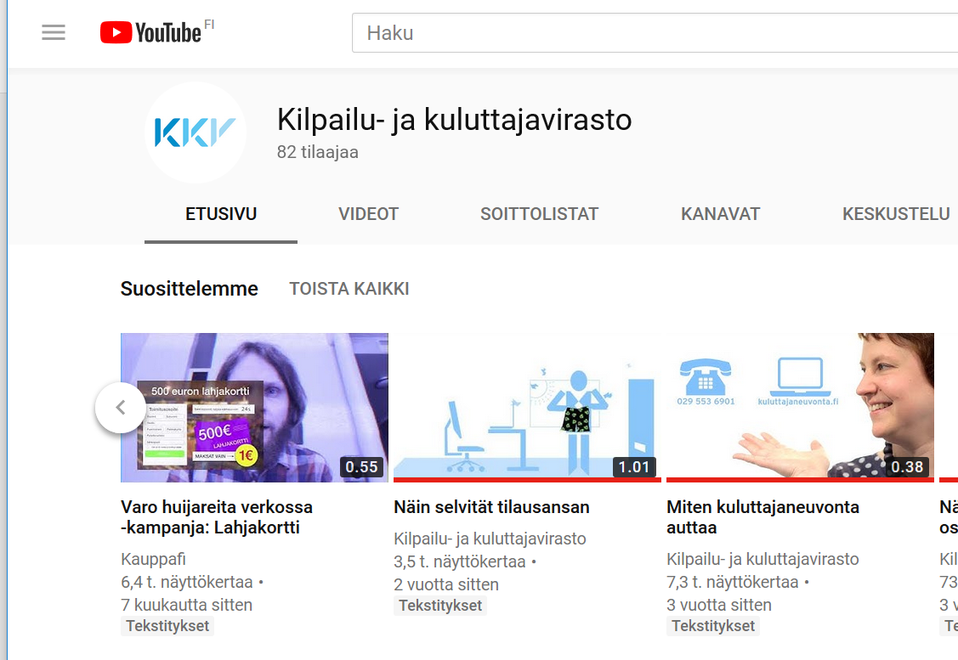
Excamples of our activities for CE
    Lecturing at university, continuing professional education
    Teacher events with teacher associations
    Taking part in national campaigns
    National Partner of Consumer Classroom
    Background materials for teachers and for lessons, YouTube

Slide 11
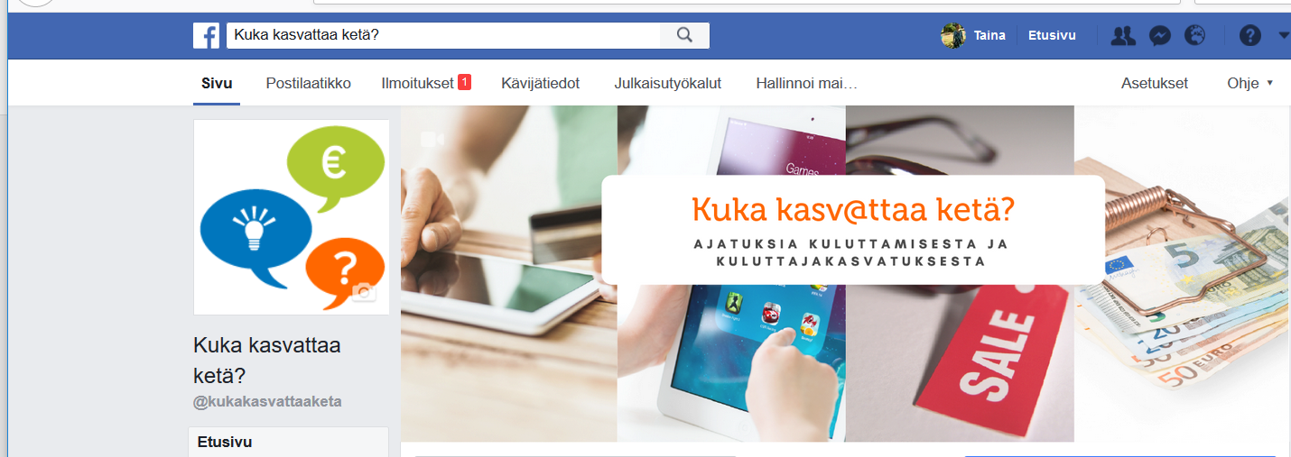
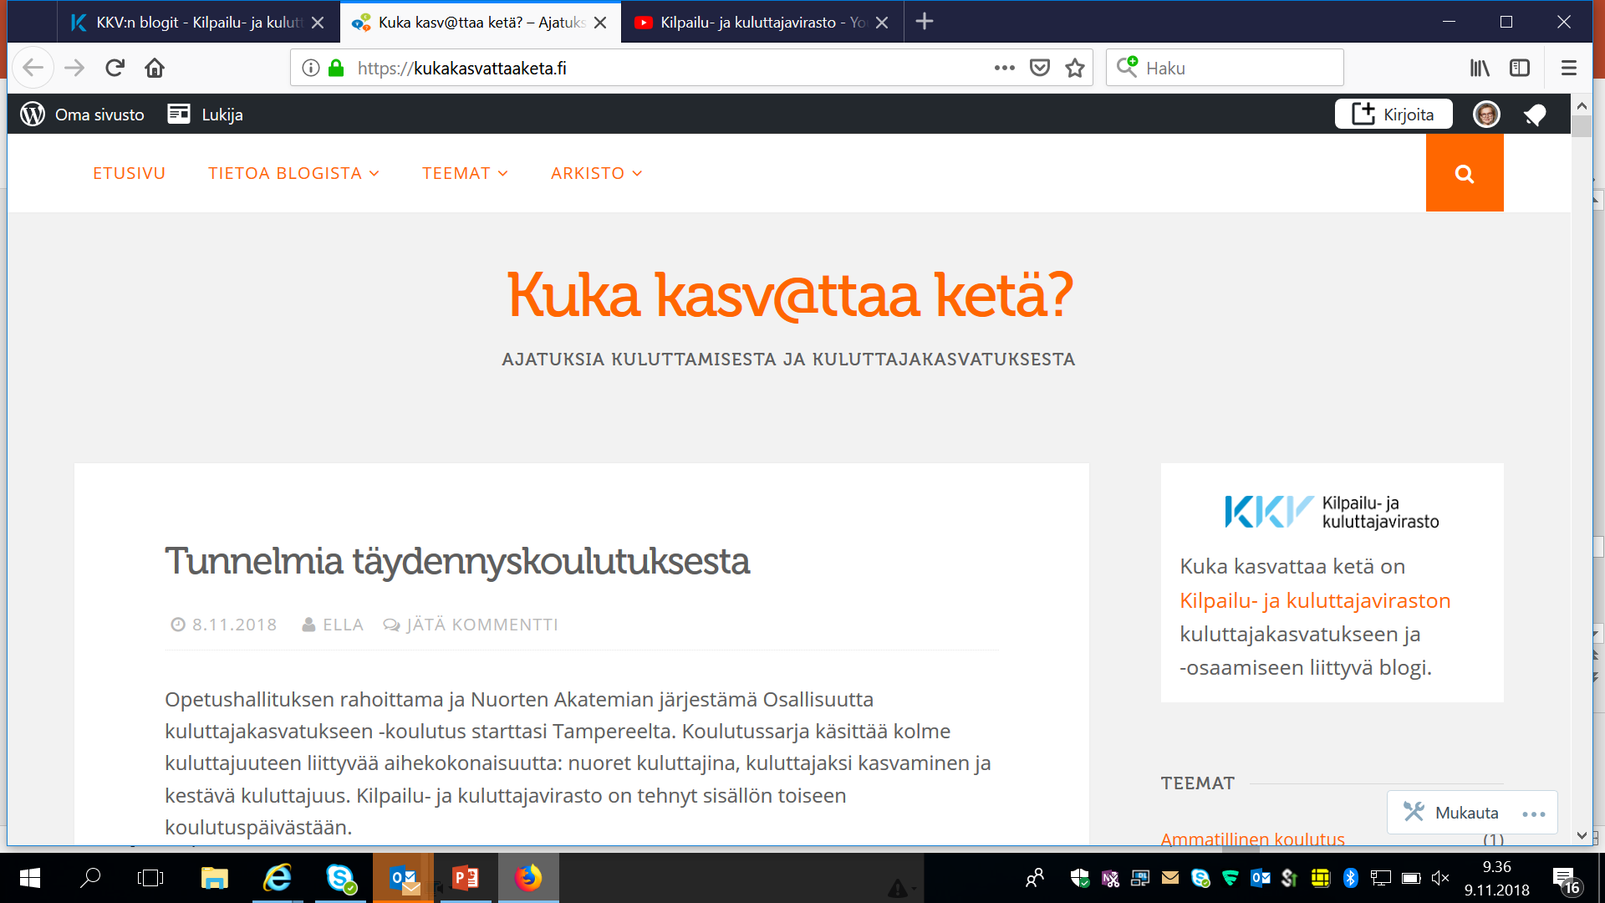
Social media for teachers and experts
Blog
FB

Slide 12
Thank you for your attention!

